Slide 1
Linked Lists: A dynamic data structure
Lecture 7

Slide 2
Array versus Linked Lists
Linked lists are more complex to code and manage than arrays, but they have some distinct advantages.
Dynamic: a linked list can easily grow and shrink in size.
We don’t need to know how many nodes will be in the list. They are created in memory as needed.
In contrast, the size of a C array is fixed at compilation time.
Easy and fast insertions and deletions
To insert or delete an element in an array, we need to copy to temporary variables to make room for new elements or close the gap caused by deleted elements.
With a linked list, no need to move other nodes. Only need to reset some pointers.

Slide 3
List Overview
Linked lists
It is Dynamic and so you can increase/decrease the size.
Unlike an array which is static: can not change the size at run time
Basic operations of linked lists
Insert, find, delete, print, modify….
Subset of linked lists
Stacks : used in the program/thread stack: Last In First Output (L.I.F.O.)
Queues: used for algorithms for scheduling processes to run on a CPU: First In First Out(F.I.F.O.)

Slide 4
Operations on Linked List
// prototypes: note data types
void insert(ListNode**, char);
char delete(ListNode*,char value);
void printList(ListNode*);
Pass ListNode variable by reference in the insert and delete function: pass the address of ListNode
Pass ListNode variable by value in the print function: pass the contents of ListNode

Slide 5
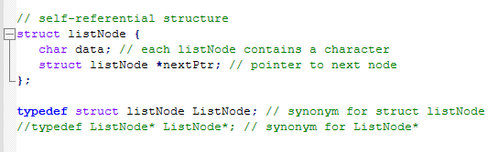
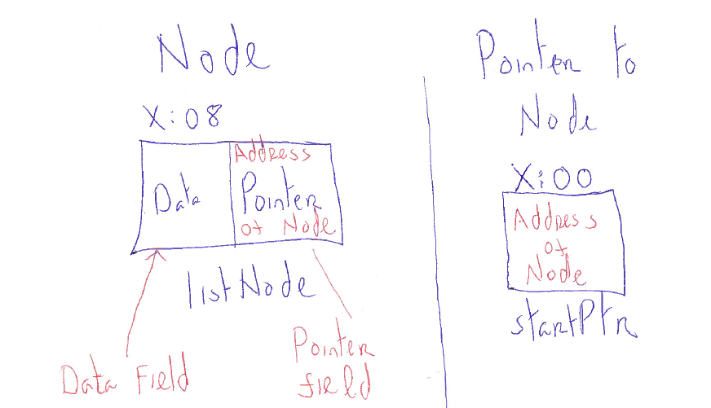
The listNode structure

Slide 6
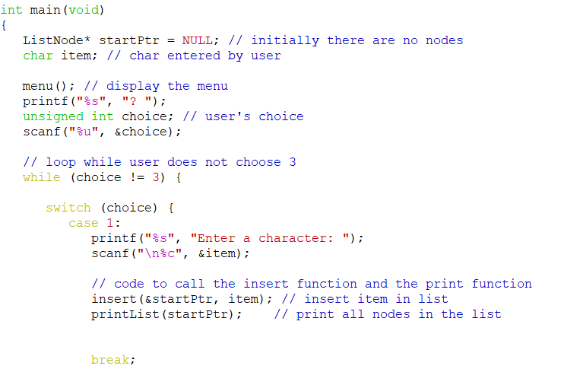
Main function (insert node)

Slide 7
Inserting a new node
Possible cases of Insert a Node
Insert into an empty list
Insert in start of list
Insert at end of list
Insert in middle
But, in fact, only need to handle two cases
Insert as the first node (Case 1 and Case 2)
Insert in the middle or at the end of the list (Case 3 and Case 4)

Slide 8
Inserting a new node
Insert a node with data equal to x (in the Link List Demo the data is added in alphabetical order)
Steps (insert function)
Allocate memory for the new node
Locate node (current) before which new node is inserted
Point the new node to the (current) node
Point the current node’s predecessor (previous) to the new node
index’th element
newNode

Slide 9
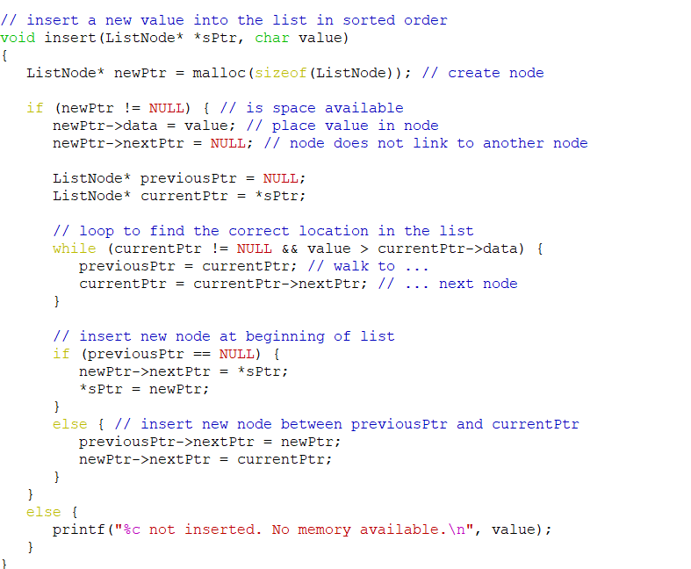
the insert function

Slide 10
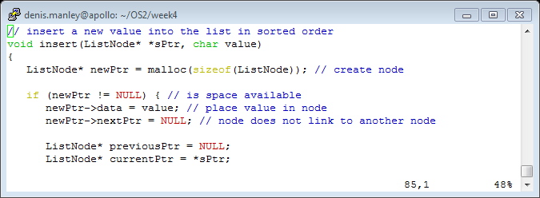
Create node and initialise pointer variable

Slide 11
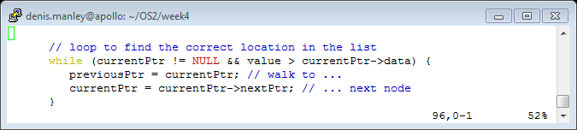
Traversing the list

Slide 12
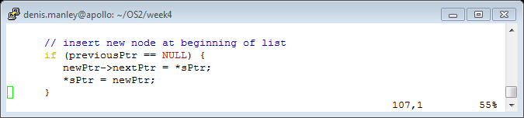
Insert a beginning of list

Slide 13
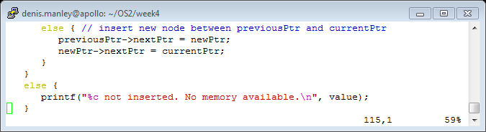
Insert node in other part of list

Slide 14
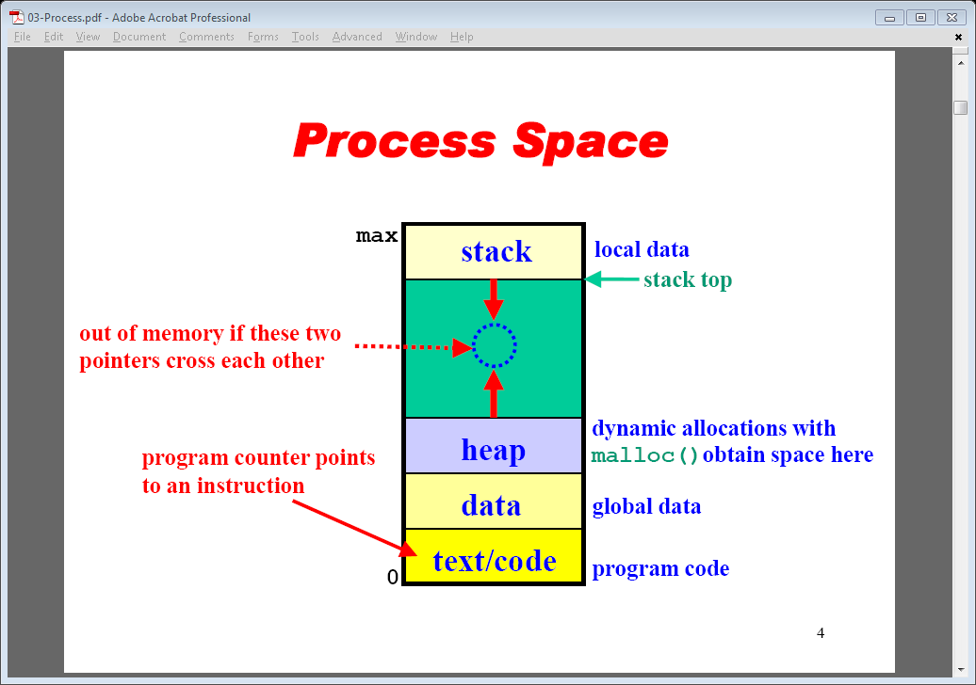
Process Space

Slide 15
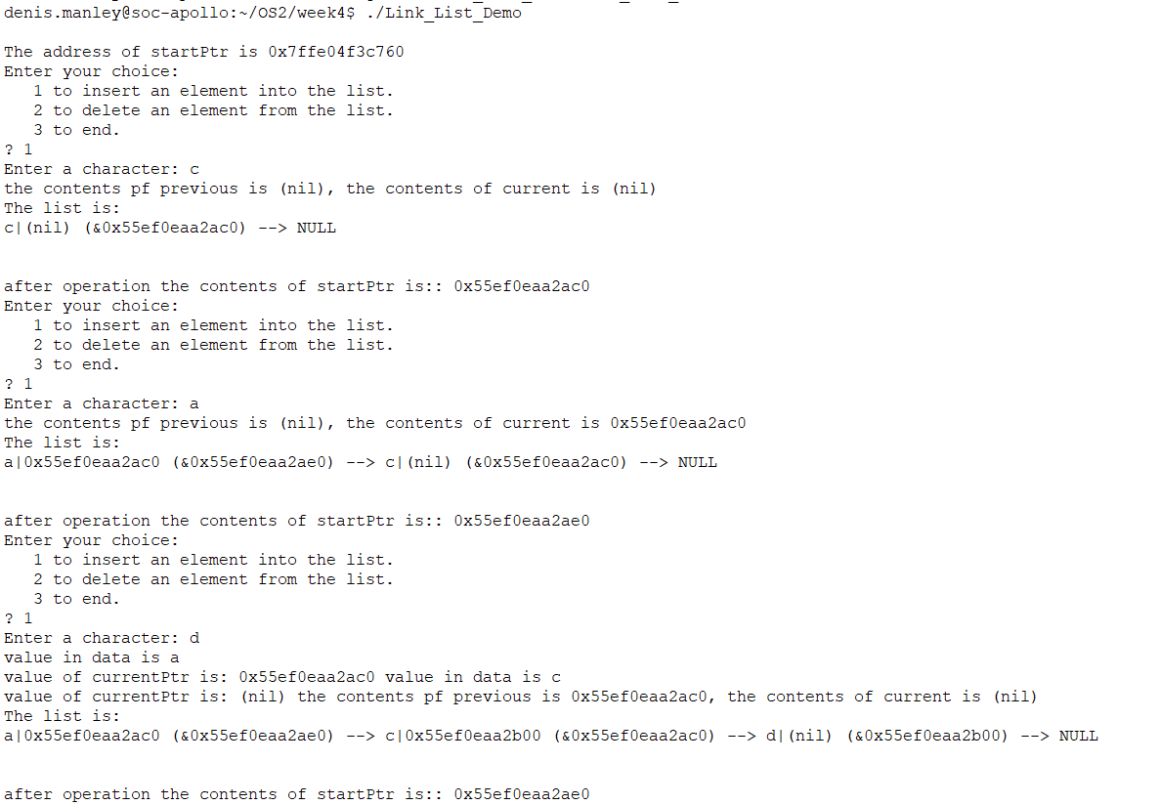
Example of inserting
Node “pointer” address
Node address
Node contents
Contents of variable in walkthrough

Slide 16
Exercise 1: insert a node empty list
Using the variable contents and addresses from previous slide: Explain, using illustrate or otherwise:
What is the contents of sPtr?
What is contents of the variables (newPtr, currentPtr and Previous Ptr) before inserting the new node?
What is contents of the variables after inserting the new node D (it is an ordered link list. )

Slide 17
Deleting a node
char DeleteNode(ListNode * *sPtr, char x)
Delete a node with the value equal to x from the list.
If such a node is found, return its value. Otherwise, return ‘\0’ (Null character).
Steps
Find the desirable node (similar to insert fnt)
Set the pointer of the predecessor (previousPtr) of the delete node (currentPtr) to the successor of the found node
Release the memory occupied by the delete node
There are two cases of deletion
Delete first node
Delete the node in middle or at the end of the list

Slide 18
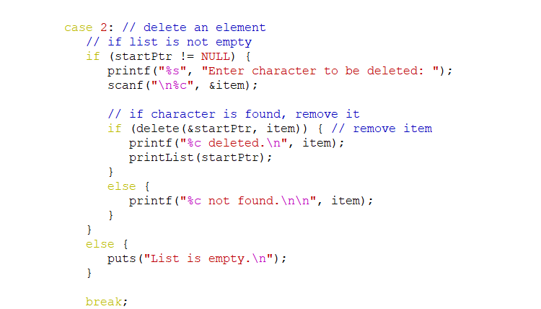
Delete a node: call function

Slide 19
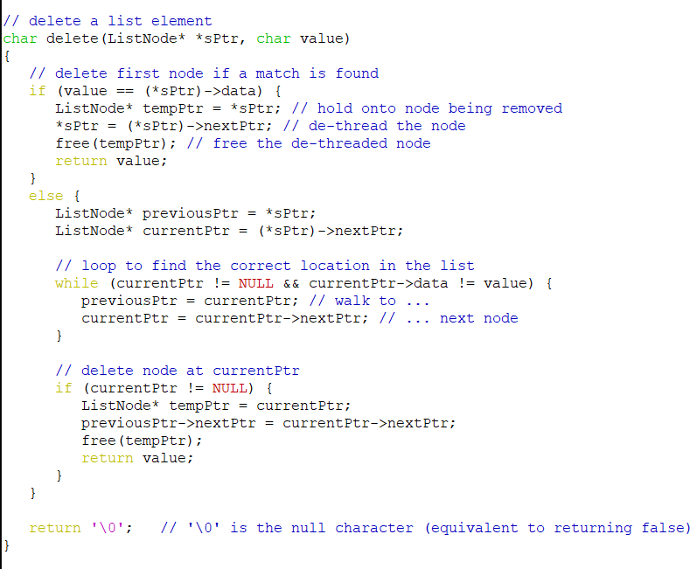
Delete function

Slide 20
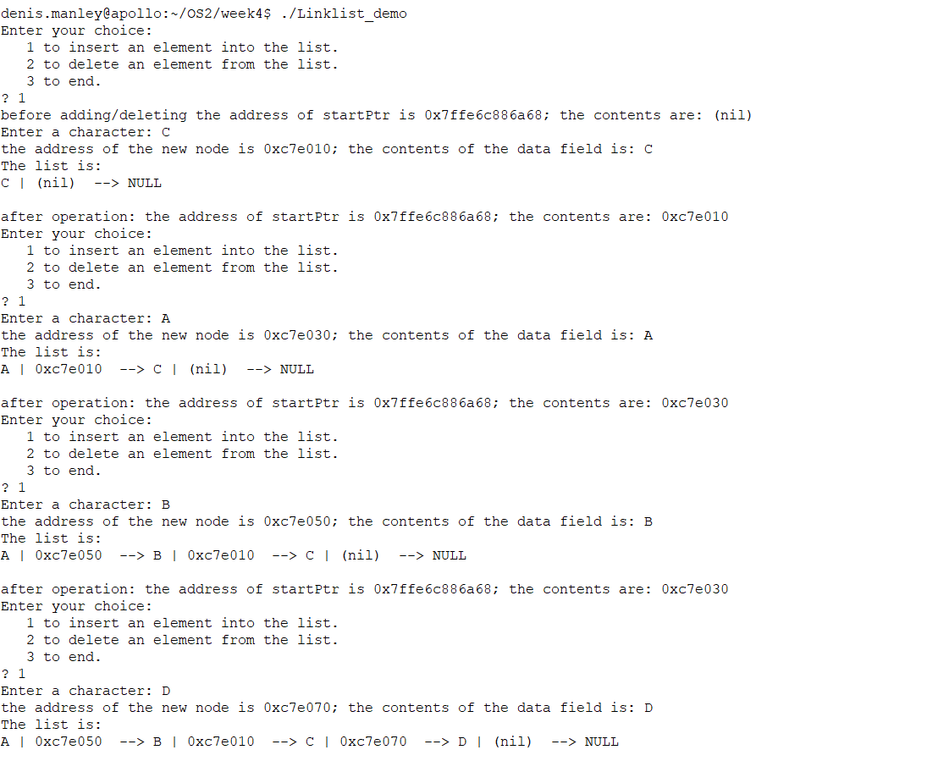
Sample output add 4 nodes

Slide 21
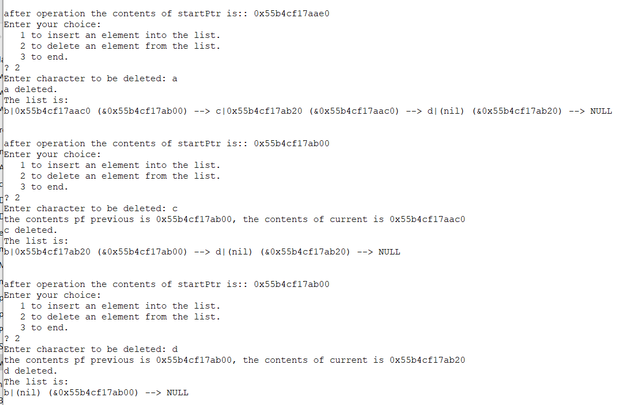
Sample output delete 3 nodes

Slide 22
Exercise 2: delete nodes from a list
Using the variable contents and addresses from previous slide to Explain using illustrations or otherwise:
What is the value (not the address) of sPtr?
What is contents of the variables (newPtr, currentPtr and Previous Ptr) before inserting the new node?
What is contents of the variable after deleting a node from the list (Assume the ordered list contains 4 nodes… )

Slide 23
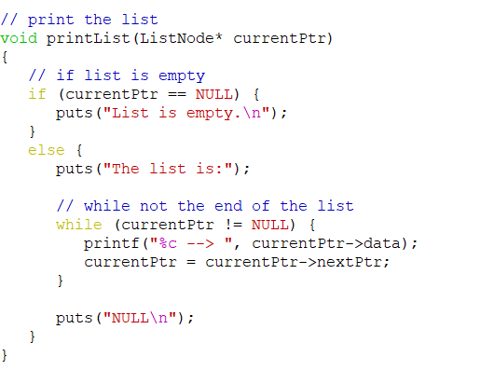
Print Function
Call the print function (use a pointer to a node node address of pointer to a node):
Print function definition

Slide 24
Exercise 3: print nodes in a list
Using the variable contents and addresses Explain using illustrations or otherwise to illustrate:
What is the initial value (not the address) of currentPtr?
What is contents of the field (currentPtr->nextPtr)?
What is contents of these variables after printing the first node (One iteration of the While loop)

Slide 25
homework
Write a function that will change the data contents of a node:
Prompt the user for the ID
Pass to a function to find a node
If found change contents. Print the list with the edited node
If not found return an appropriate message

Slide 26
Sample Exam Question
Why is a link list a more efficient way of utilisation of memory than arrays (3 marks)
Explain, using a simple example, how the add/delete functions , in a link list program, use pointers to keep tract of any changes made to the pointer to the beginning of the list (Head) (5 marks)

Slide 27
Sample Question
Clearly explain, using suitable examples, the steps required to:
Add a node into an ordered link list: at the start at the middle and at the end (10 marks)
Delete a node from an ordered link list, the start, middle and end of a link list (10 marks)

Slide 28
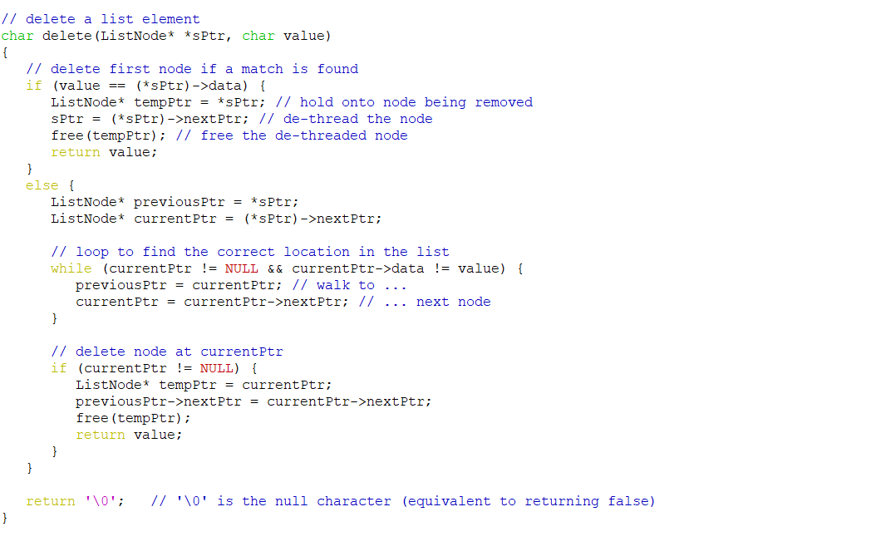
Clearly explain if the following code will delete a node from a link list (10 marks)

Slide 29
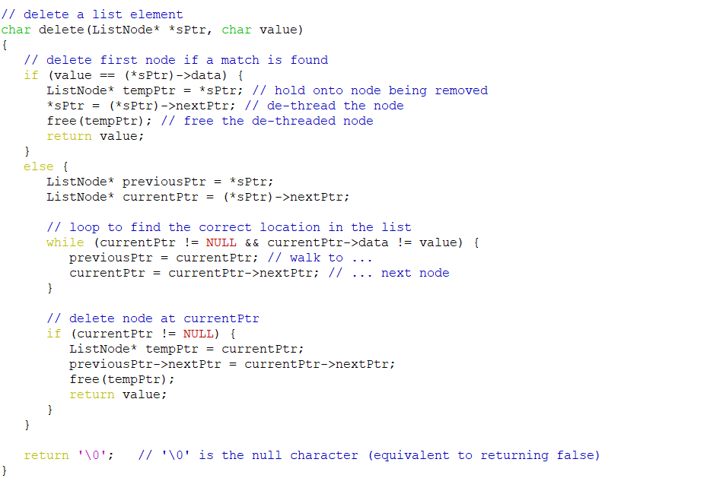
Clearly explain if the following code will delete a node from a link list (10 marks)

Slide 30
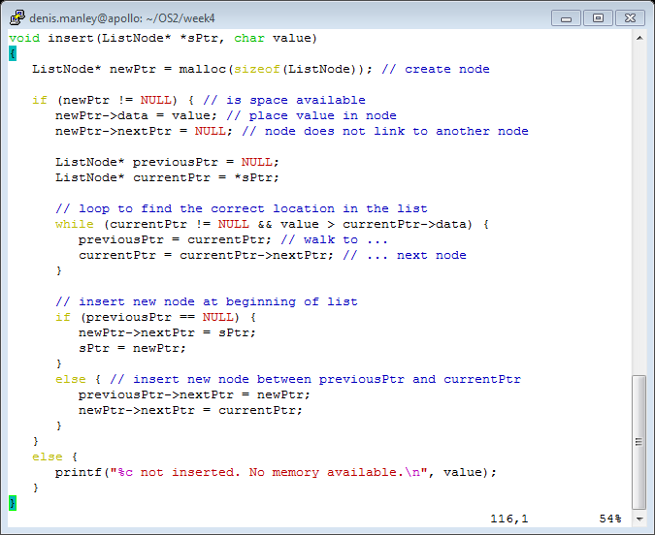
Clearly explain if the following code will insert a node onto a link list (10 marks) note the comments will be removed in the exam

Slide 31
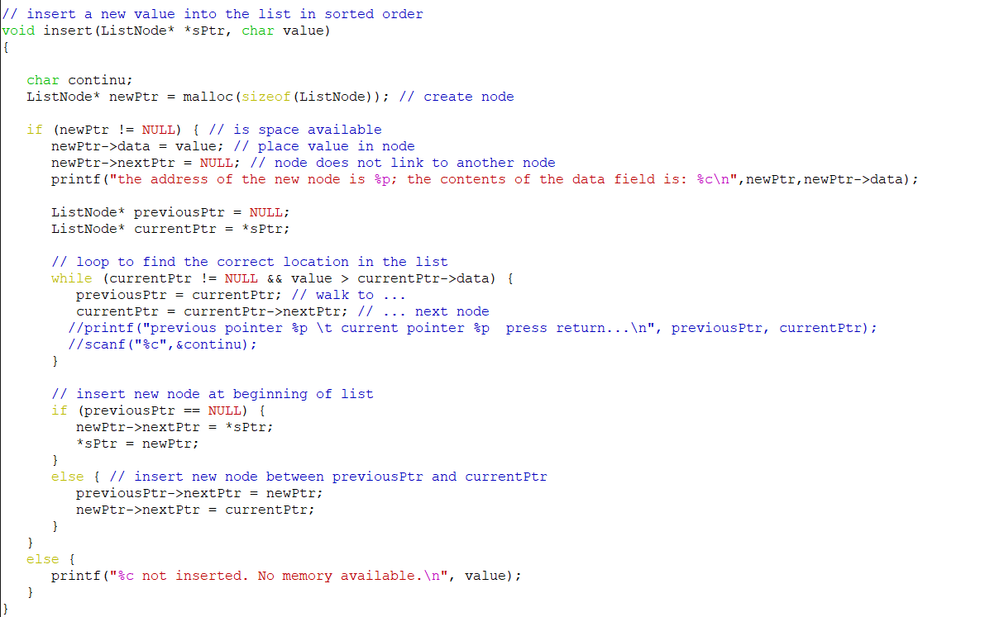
Clearly explain if the following code will insert a node onto a link list (10 marks) note the comments will be removed in the exam

